Slide 1
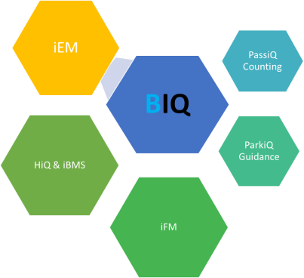
HIQ – building intelligence
Automation & BMS
operation
Facility Management
Optimization in real time
PRODUCTS & SOLUTIONS FOR BEST BUILDINGS & EFFICIENT BUSINESS

Slide 2

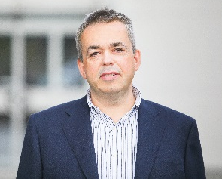
Buildings are part of the connected world !
Our world is facing changes as newer before. Cities, building, vehicles and even people are connected and on-line. Internet of Things (IOT), Cloud computing and smartphones transformed the way we conduct our lives and business. Are we ready? Are our buildings really performing at their best? Do we optimize total cost of ownership and are we reay for future.
We, at Robotina are ready. We invested in research, developed products and solutions and we are ready to support you. Let us lead digital transformation of your buildings & business. You will discover unbelievable benefits.
Devid Palcic, president&CEO
Notes:
This PPT is related to buildings .....know how, not for conferences ....FOR END USER / CLIENT
Single platform !!!!!

Slide 3
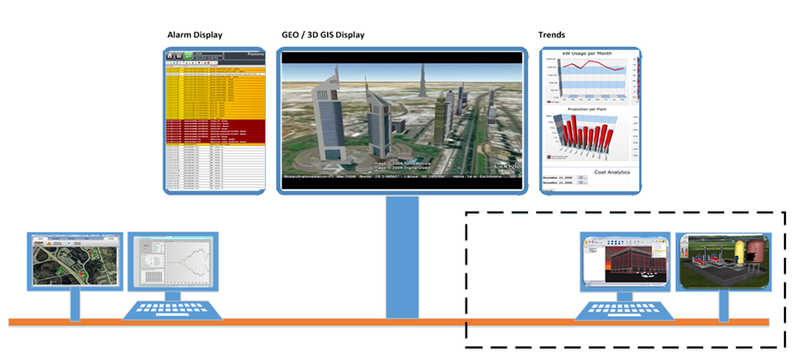


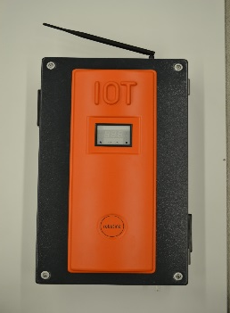


Building Management and optimization - overview
CLOUD BASED services:
ROBOTINA COS, AI, machine
learning, dashboards,…
ON LINE optimization
Facility management operations center by FM company
ON LINE operation
REMOTE
ON SITE
…
user
IoT linker
Notes:
This PPT is related to buildings .....know how, not for conferences ....FOR END USER / CLIENT
Single platform !!!!!

Slide 4


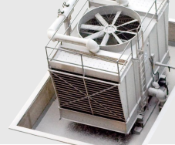

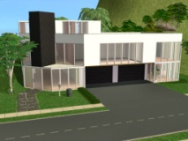
From Automation to BIQ – sustainable building intelligence
Automate
Connect
Offices
Hospitals
Malls
Schools
Airports
BMS
Facility Management
COS
Building IQ in Business
Fault detection
Maintenance
Informed action
NOC
Fleet management
All Assets
Analyize
Dynamically optimize
Save
Subscribe
businesses
Integrate data
SUB BILLING
Corelate
Act
Operations
Strategy
Home
Automate
Connect
Villas
Appartments
Residential
Automate
Operate
Optimize and use for business
Single platform
Integrated solution
FROM AUTOMATION TO BI - COMPLETE SOLUTION FROM MANUFACTURER
Notes:
This PPT is related to buildings .....know how, not for conferences ....FOR END USER / CLIENT
Single platform !!!!!

Slide 5
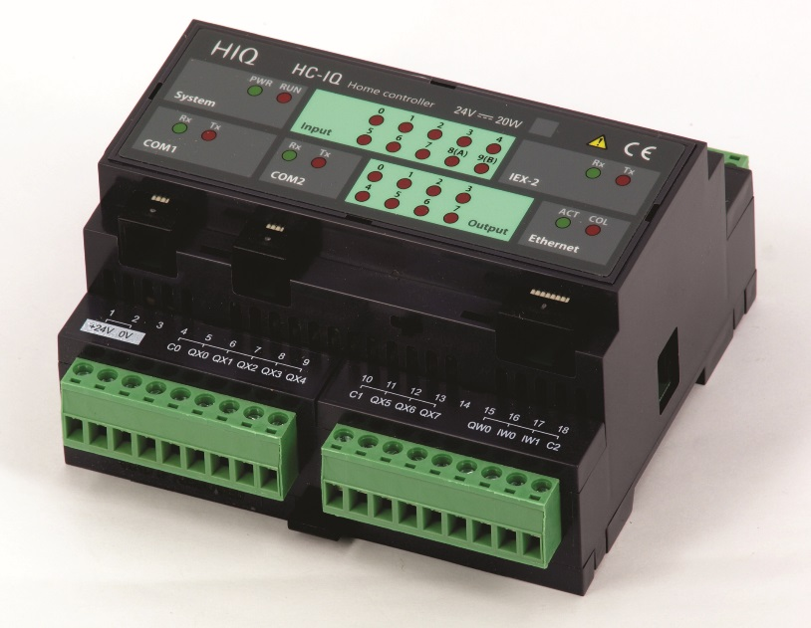

BMS – building intelligence
KEY BENEFITS FOR INVESTOR
The lowest possible Total cost of ownership – minimized energy, maintenance and downtime cost
Improved safety and security
Efficient FM
KPI‘s and dashboards for improvement
Support for Leed‘s Bream and Green Building Council certification
new, 3rd generation controller
Extremelly fast processing time
Large program and data memory
IOT compatibility for easy integration
Intelligent I/O modules
Commucation with all types of serial devices
Efficient programming & design
3rd GENERATION MASTER CONTROLLER
Notes:
Villas, appartments, residence

Slide 6



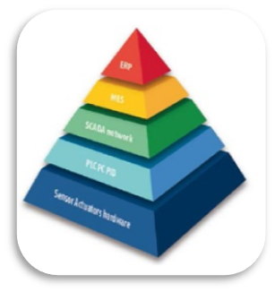
Building Management System
AUTOMATION & INTERFACING
Notes:
Villas, appartments, residence

Slide 7
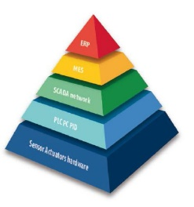
Layers of BMS
To BIQ level
SCADA - OPERATIONS
Operate: Build on 64 bit technology with advanced functions
Alarming, trending, analyising
2D / 3D graphics for live view– gives a fantastic user experience
Open conectivity and easy integration with other systems
IOT linker
Connect various systems and unify the data structure: connect everything
Connect intelligent equipment (chillers, HVAC, security, fire, access…)
Other SCADA systems with controller stucture
Any standard protocol
BMS Controllers
Automate and control: Unique distributed structure
PLC / controller network on Ethernet backbone
Different interfaces for 3d party systems
OPC connectivity, any type of I/O
Notes:
OSI
How our system is build – in layers

Slide 8
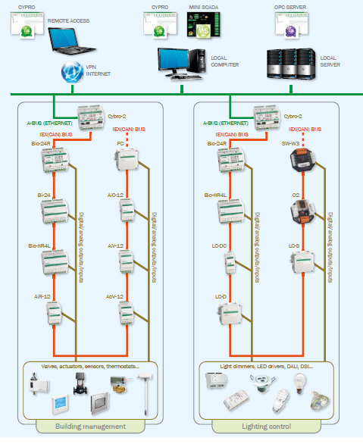

Automation Hardware
Distributed Architecture
Easy Config & Flexible
Scalable
Device oriented
Programmable
FREE & SCALABLE ARCHITECTURE FOR EASY SYSTEM INTEGRATION
Notes:
General description of our system

Slide 9
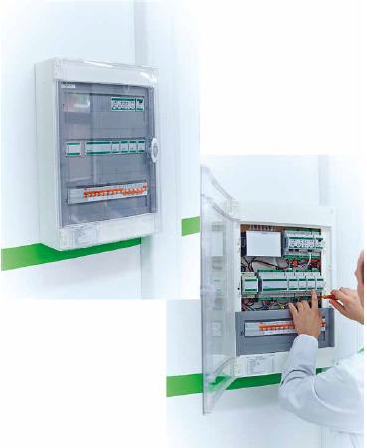
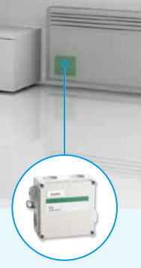
Efficient Installation
Large modules variety
Field mount
Cabinet mount
Wall mount
Embeded inside devices
INSTALL WHEREVER NEEDED – EASY, FAST, EFFICIENT
Notes:
Different types of mounting / installation – focus on „pick up the module you need“

Slide 10
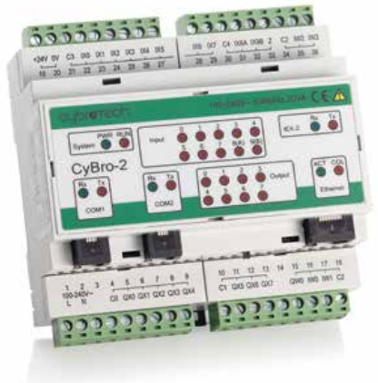

Main Controller
Fully programable
EN 61131-3
Wide conectivity
Ethernet
Serial (RS232,485)
WiFi
Industrial grade
230V AC or 24V DC supply voltages
35mm DIN rail mounted
Opto isolated inputs
Communication and status LEDs
Performance
Advanced ARM CPU, large user memory, multiprocessor structure
Ethernet and 2 x RS232 open protocol ports
CAN communication with expansion units
10MHz high speed counter
Fully vertical integration from devices to cloud
POWERFULL UNIVERSAL DDC CONTROLLER – FOR ADVANCED CONTROL AND CONNECTIVITY
Notes:
Top quality and performance controller

Slide 11








IOT & Connectivity
Open conectivity
INTERNET / ETHERNET
GSM/PRS
MQTT
OPC, …
Free Network topology
Open protocol
Varius protocol supported
Special COM modules
Notes:
Connect in any way from any device any time
Protocol support -> open standards

Slide 12
High level Connectivity
Controller level network
Operator layer
Graphical user interface
Local, mobile and remote access
Data logging
System integration layer
Based on TCP/IP
OPC Server
Remote programming & maintenance
Network of decentralized controllers
Connection to other automation systems
CONNECT ON ALL LAYERS USING VARIOUS PROTOCOLS
Notes:
Looking up...TCP/IP conectivity ..backbone on TCP/IP – standard CAT5 cable

Slide 13
Control everything
HVAC
HVAC
FCU
VAV
Chillers
Room Control
Light control
ON/OFF
DALI
DSI
Analog
DG, UPS, PUMPS..
Monitor of crucial systems
Access control, CCTV
ID, tags, RFID
Soft key
Time & space
People counting, occupancy, density, foot fall
Car Park Management and guidance
System integration
Integration of all differnet systems in buildings
Security & Safety
CCTV
Fire detection and prevention
Auxiliarly systems
PV plants, energy systems, transformer stations
Integration of ALL systems for Synergic results!
Notes:
This and next slide just to asure the customer - we know what we are talking about, we have the tools (HW / SW) and expercience

Slide 14
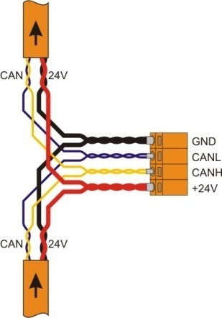
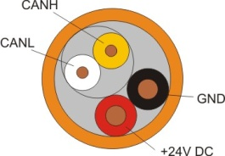
Efficient I/O expansion – single cable
Intelligent I/O Network
CAN bus for fast and relible communication
Up to 31 expansion modules in free bus technology
No DIP switches, all modules are autodetected
Adding modules without effecting exhisting system
Intelligent 4-wire modules: digital, analog, RTD, modbus, serial,…
Notes:
Easy build and connect the system
Tools for BUS network errors, LED´s in each module.....

Slide 15
Hardware
Range
Functionality
Digital and analog I/O
Temperature, humidity, illumination
DALI, DSI, IR comm.
Serial comm modules
New modules on request
Small quanties
Low costs, efficient design
Fully customizable
FULL RANGE OF EXPANSION MODULES – CONNECT ANY I/O OR DEVICE
Notes:
We have (manufacture) the modules which cover all customer / project specification ...
1/0, Analog 0-10, 4-20mA ....PT,
Communication modules ...specific MP BUS, M BUS....
GSM module.....

Slide 16
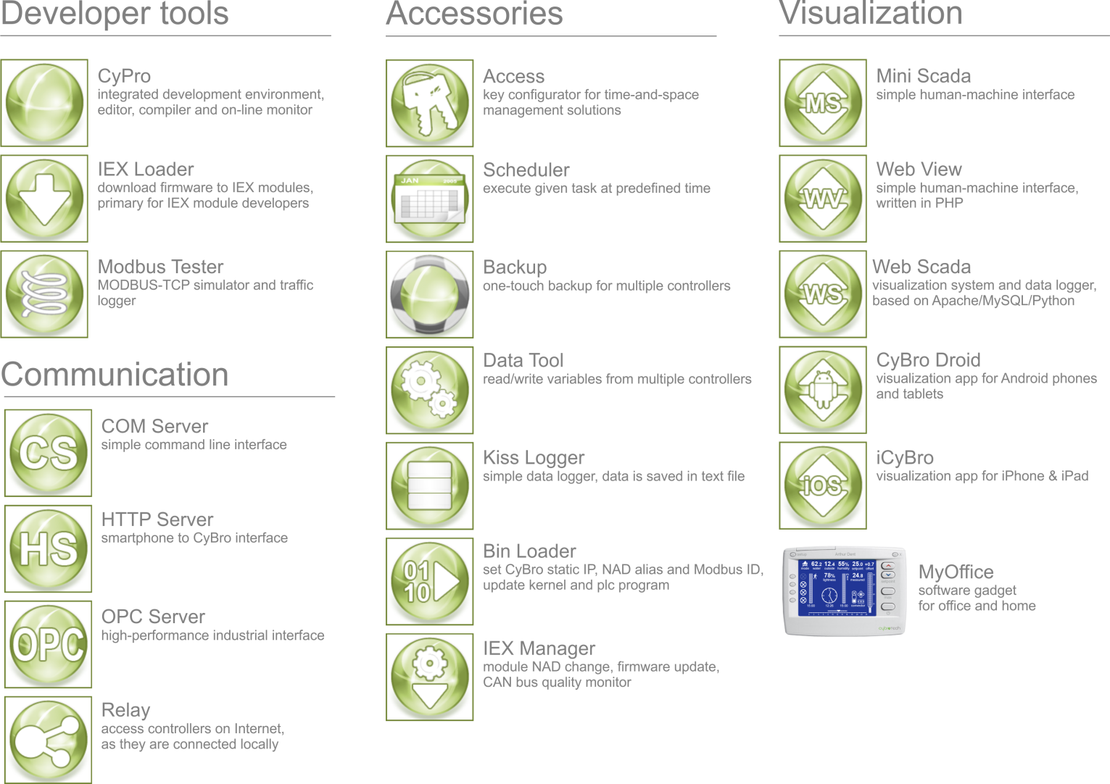
Software
Tools
Time saving for Developers, System integrators and Instalers
Graphical interfacess, schedulers and logging tools for end users
From controller to cloud and back
POWERFULL TOOLS FOR SYSTEM INTEGRATORS

Slide 17
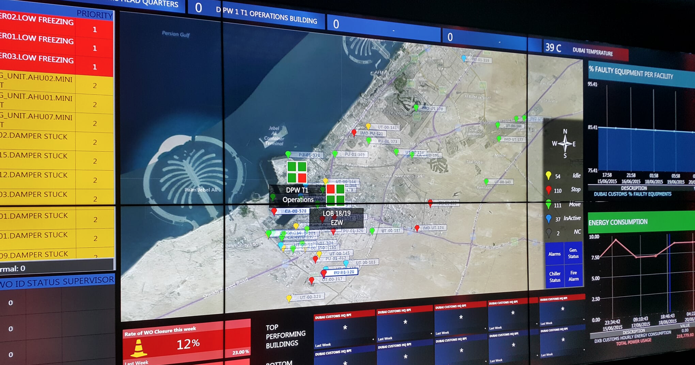
SCADA & NOC – operating buildings & FM
DAILY OPERATION, MAINTENANCE, ANALYTICS, DASHBOARD, WORKFLOW,…
Notes:
Villas, appartments, residence

Slide 18
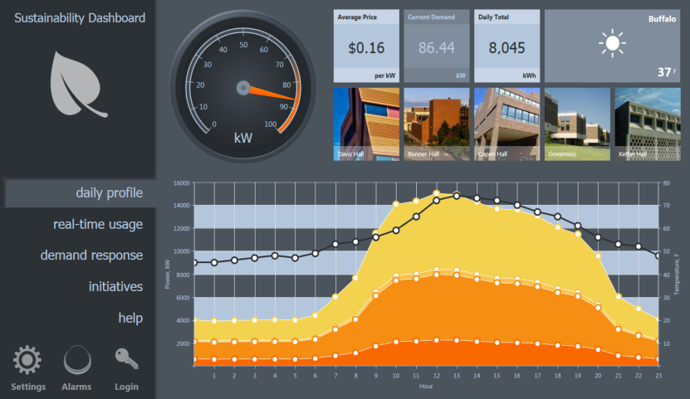
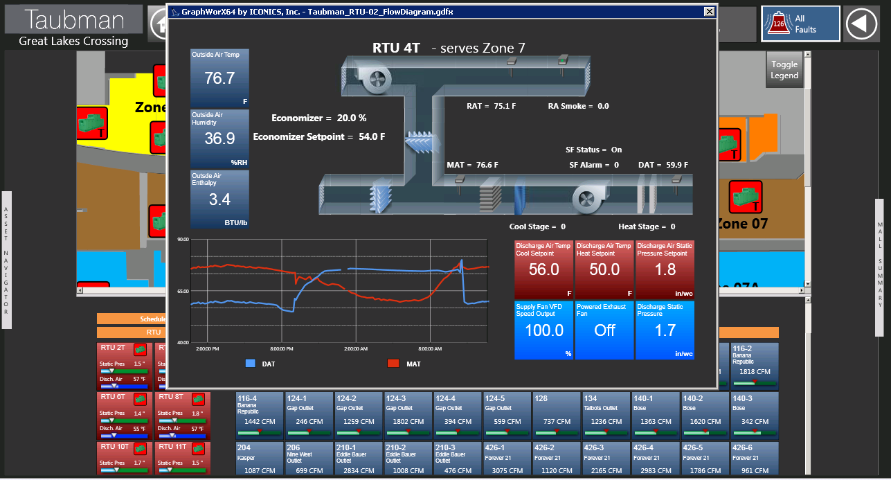
Operator‘s Front end – SCADA layer
Visualisation
3D and 2D Graphics
3D and 2D import
Animate Anything
Command and Control
Picture in a Picture
Publish to any Device
VIEW, ANALYZE AND ACT – INFORMATION BASED ACTION FOR EFFICIENT OPERATION

Slide 19
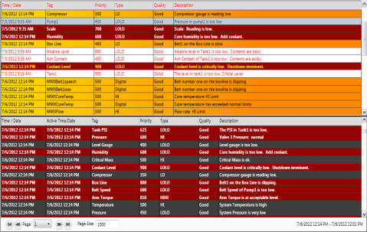
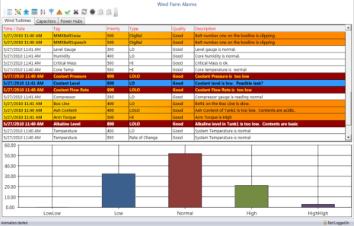
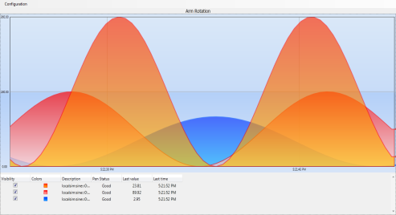
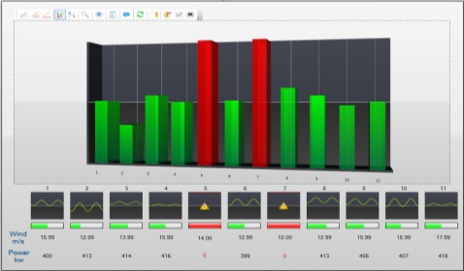
Alarms & Trends
Alarms
Trends
Unlimited Alarm views
Filter and Sort on any Criteria
Real-time & Historical Tags
Customizable Viewer
Alerts, Emails, SMS, Skype
Operator Annotations
Various Chart Types
Stacked or Tabbed Charts
Graphical Analysis
Real-Time and Historical
Runtime Toolbar
GraphWorX Embedding
CONTROLLED ALARMS LIFECYCLE AND USEFUL TRENDS FOR ACTION

Slide 20
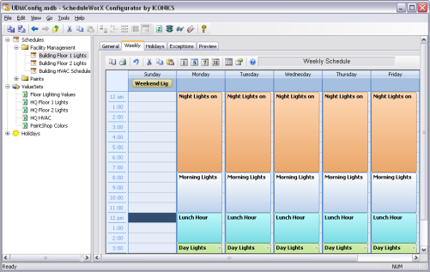
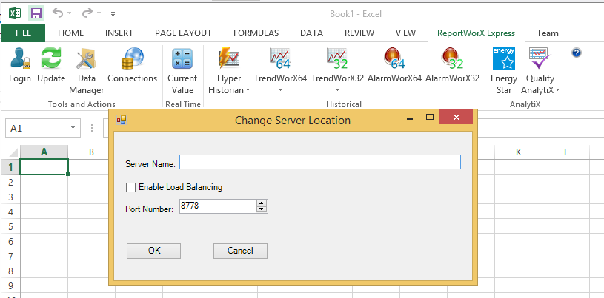
Everything for efficient operation
Scheduler
Reporting
Outlook-style Configuration
Holiday, Seasonal and Override Support
Excel-based Reporting
Parameterized Reports
Automatic Command Execution
All Day & Timed Events
Excel Task Pane Integration
Simple & Easy to Use
AUTOMATIZED AND CUSTOMIZED REPORTS FOR EFFICIENT MANAGEMENT

Slide 21
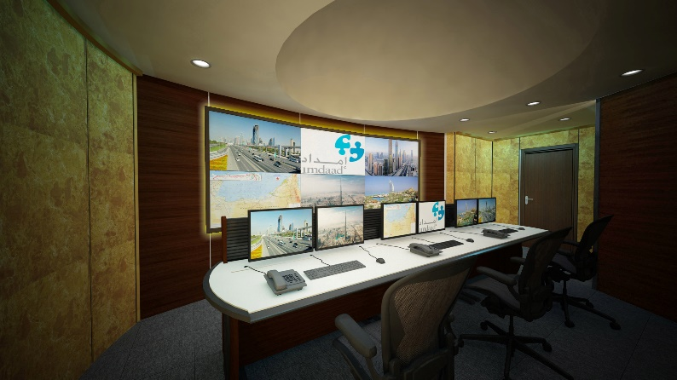
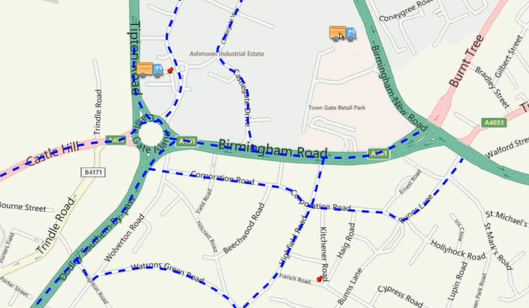
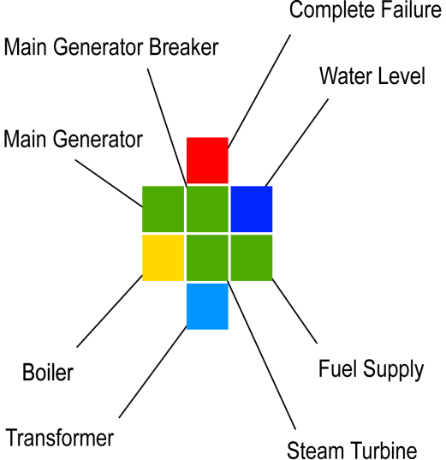
Command
center
Integrated operations
Geographical correlation & Fleet management
Visual Feedback for Problem Identification
Workflow management & ERP integration
NOC level integration, 24/7 operations, single point asset management, maintenece team management
OPERATE ONE OR MORE BUILDINGS FROM ONE CENTER – OPERATION AND FACILITY MANAGEMENT THAT BRINGS VALUE
Notes:
Maps – smart PIN
Vehicle tracking integration
Integratiob with higher level Asset management platform
24/7 – from a single location
Detailed visualistaion of equipment / status / set points....

Slide 22

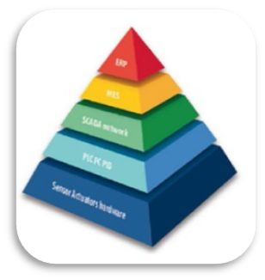

BIQ – building intelligence
REDUCE TOTAL COST OF OWNERSHIP COST AND IMPROVE BUSINESS RESULTS
Notes:
Villas, appartments, residence

Slide 23
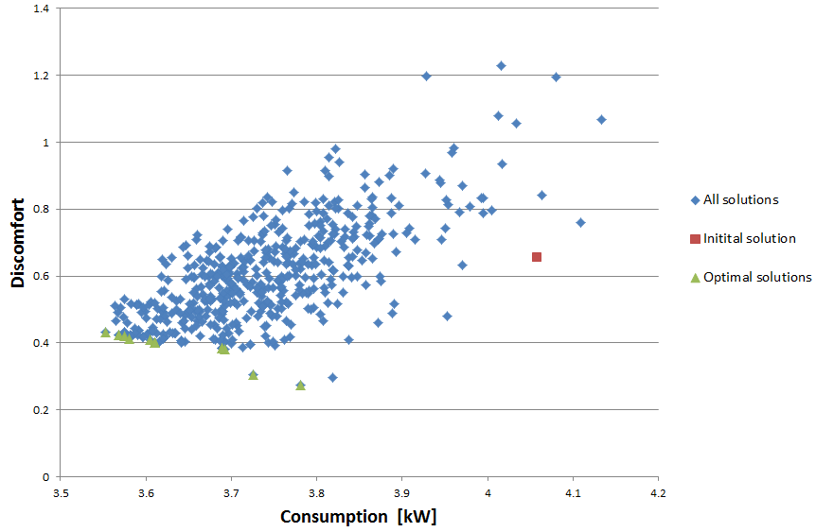

COS – Cognitive Optimization for maximization of cost/performance
OPTIMIZE & SAVE WITHOUT CHANGING HARDWARE
2015: demonstrated and proved up to 30% savings are possible without important discomfort
2016: behaviour based optimization & multi-objective optimization EU patent filed
2017: COS developed and implemented
Notes:
Villas, appartments, residence

Slide 24
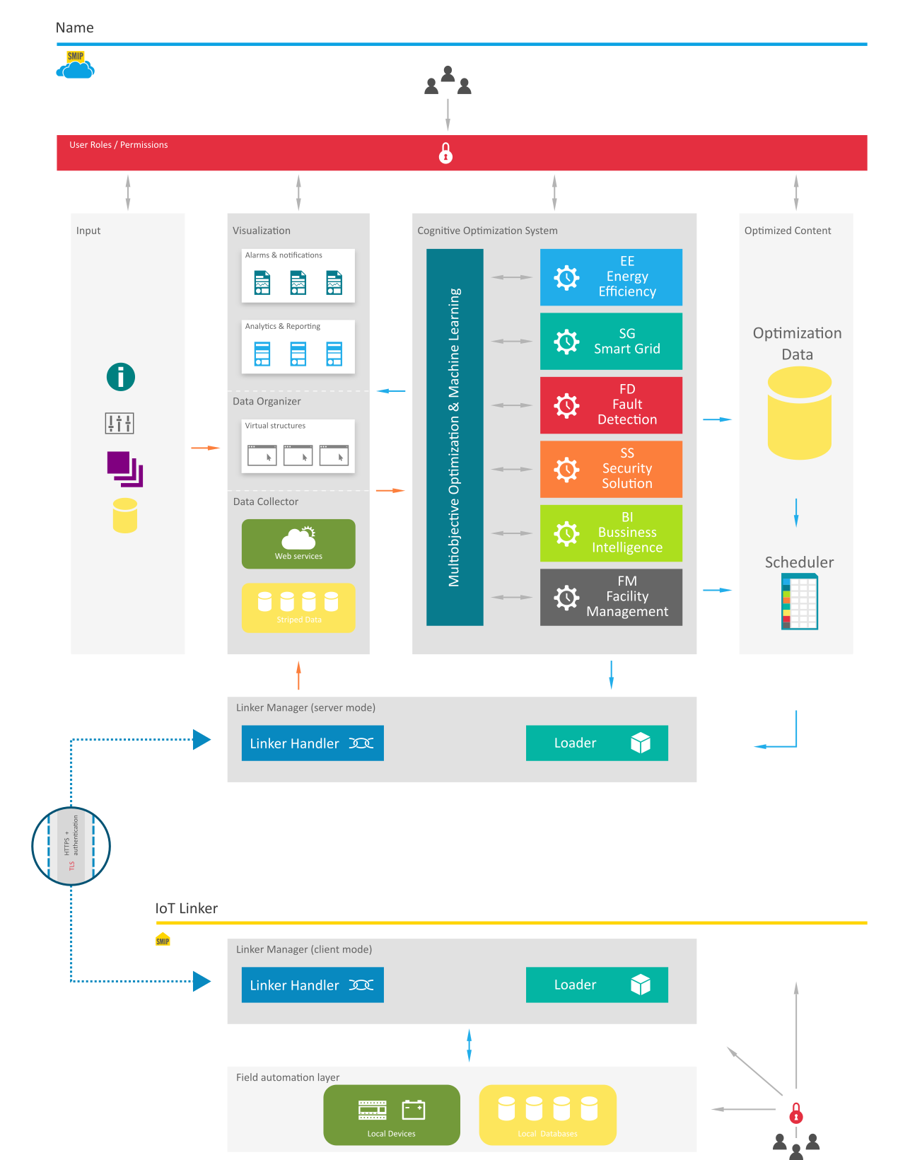

COS – Cognitive Optimization
Provides real benefits by optimizing in real time
COS – the real performance booster
Machine learning & multiobjective optimization
Cloud based and availabe as SaaS
BMS and automation vendor indipendent
Immediate results (up to 30% savings) with limited investment
Software based solution
Intensive use of IoT and Cloud services
Measurable results
Automatically calculated footprints (cost, sustainability,…)
SAVINGS AND BUSINESS BENEFITS WITHOUT HARDWARE CHANGES BY EXTENSIVE USAGE OF CLOUD, SOFTWARE, MACHINE LEARNING AND MULTIOBJECTIVE OPTIMIZATION

Slide 25
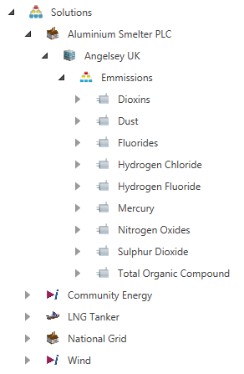

COS: Asset view
Asset´s
Massive Scalable Systems
ISA95 Hierarchy
Normalize,
Cache & Poll
Linked O&M documentation and support
ASSETS FOCUSED ANALYTICS & OPTIMIZATION – KNOW AND ACT
Notes:
support massive systems using an object oriented model based on the ISA95 standard. It provides the means to store, cache and checkpoint the tags that are used in the equipment properties, and it functions as the organizational base

Slide 26
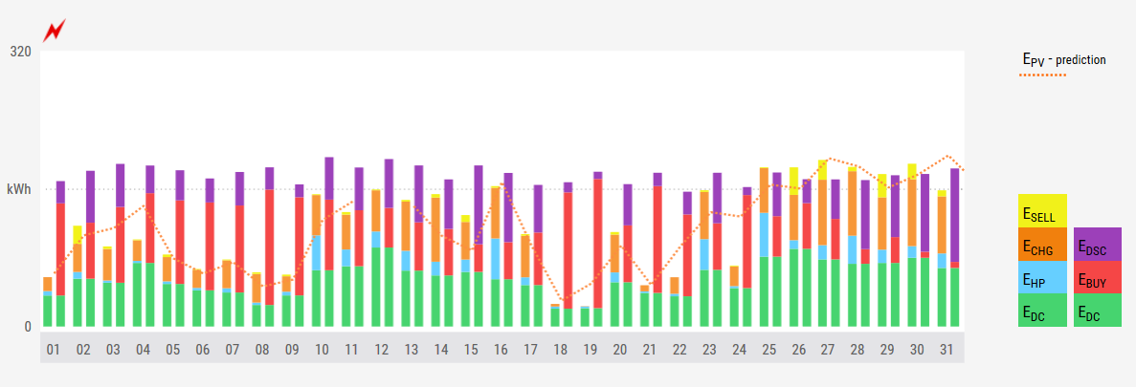
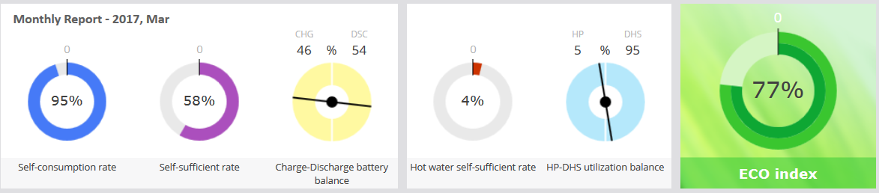
Analyze and act: KPI
KPI‘s
Key Performance Indicators
Asset, building and operations
Constantly improve
Link building and business
CLEAR DASHBOARDS and DYNAMIC CHANGE TO MOTIVATE
Notes:
support massive systems using an object oriented model based on the ISA95 standard. It provides the means to store, cache and checkpoint the tags that are used in the equipment properties, and it functions as the organizational base

Slide 27
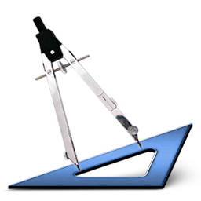
COS: Fault detection
& prediction
Predict, reduce and eliminate equipment downtime
Automate fault detection and deliver real‐time notifications
Reduce maintenance and determine probable causes
Improve reliability and control
UP TO 30% SAVINGS THROUGH FDD, RULES AND MACHINE LEARNING
Notes:
WHY what is the GOAL

Slide 28


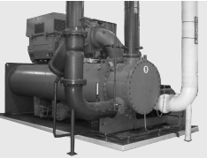
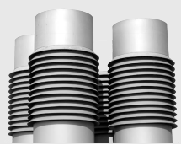
COS: FD saves money
Fault Detection and Diagnostics (FDD) Engine
IMPROVE
When equipment failures occur, real-time advanced hardware and software technology provides automatic guidance to a list of causes sorted by probability, resulting in reduced downtime and lower costs to diagnose and repair
DIAGNOSE
Powerful rules, Diagnostic Engine
DETECT
Online & offline help, O&M Logs, Wiring diagrams, Manuals, Guides, Parameter lists and phone numbers for support just with a mouse click on an asset.
Notes:
Fault Detection and Diagnostics (FDD)
Monitor and Predict Building Equipment Performance
- Chillers, Boilers, AHU, VAV, VFD
Detect Problems Before Failure Occurs
A Predictive Maintenance program aims to identify the presence of a defect in such a way as to give sufficient time for the
maintenance department to identify the root cause of the problem, efficiently order the parts, and schedule and complete the repair before a failure occurs

Slide 29
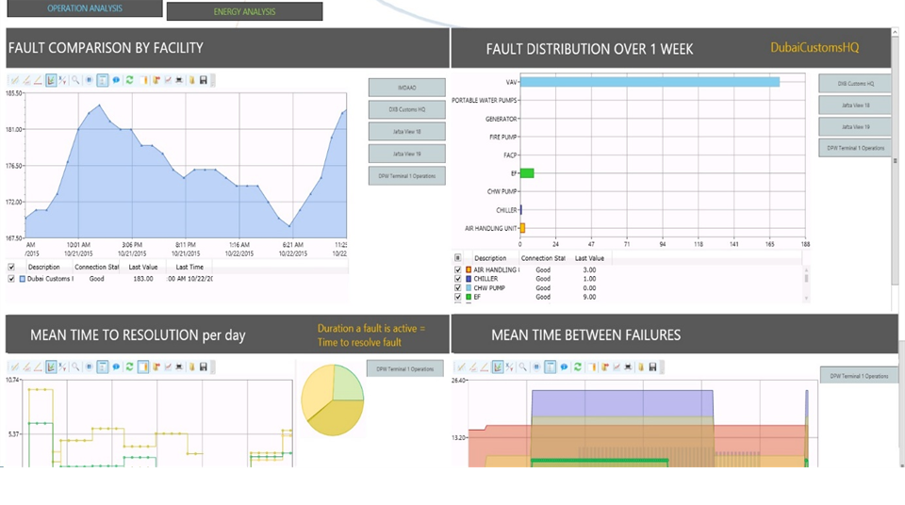
Fault detection and support to (re)action
Fault Detection & Diagnostics
Logic for Predicting Faults
Knowledge Capture & Ranked Causes
Linked O&M documentation and support
PREVENT FAULT COST, ACT INFORMED, PREVENTIVE MAINTENANCE BASED ON PREDICTION OR SCHEDULE

Slide 30
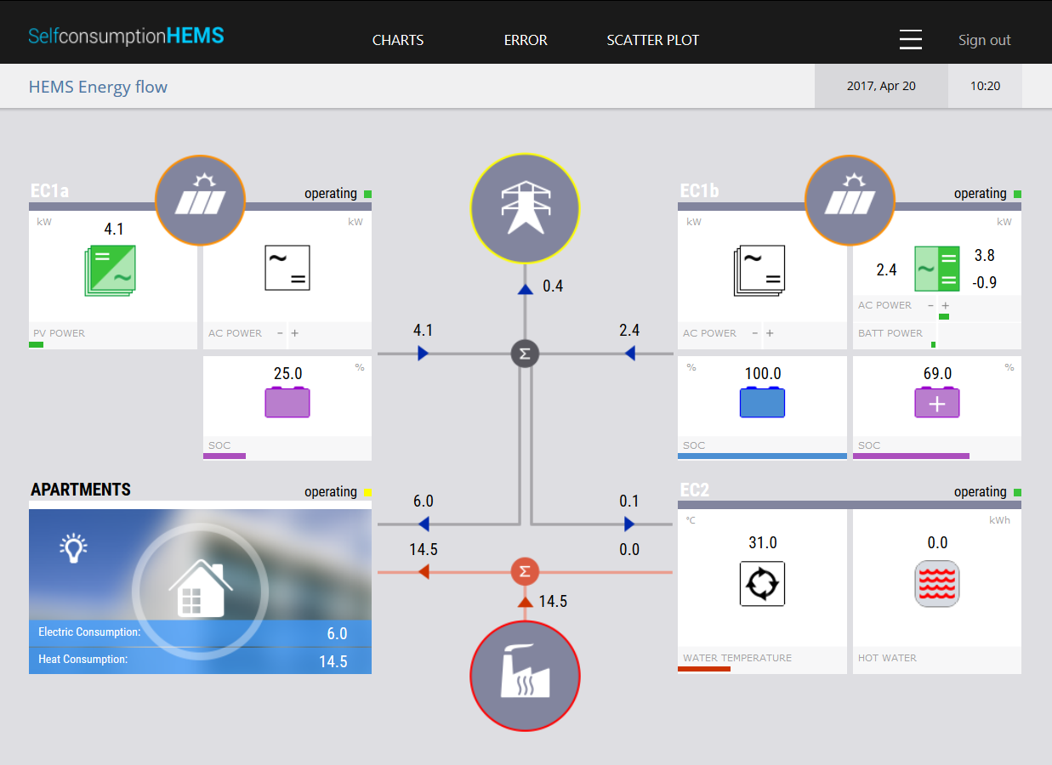
EE – reduce energy cost
BEMS – building energy management
Measure & analyze
Rules based optimization
Machine learning
Artificial Intelligence
BEAHAVIOR INTELLIGENCE, DYNAMIC OPTIMIZATION, SMART GRID
Notes:
support massive systems using an object oriented model based on the ISA95 standard. It provides the means to store, cache and checkpoint the tags that are used in the equipment properties, and it functions as the organizational base

Slide 31
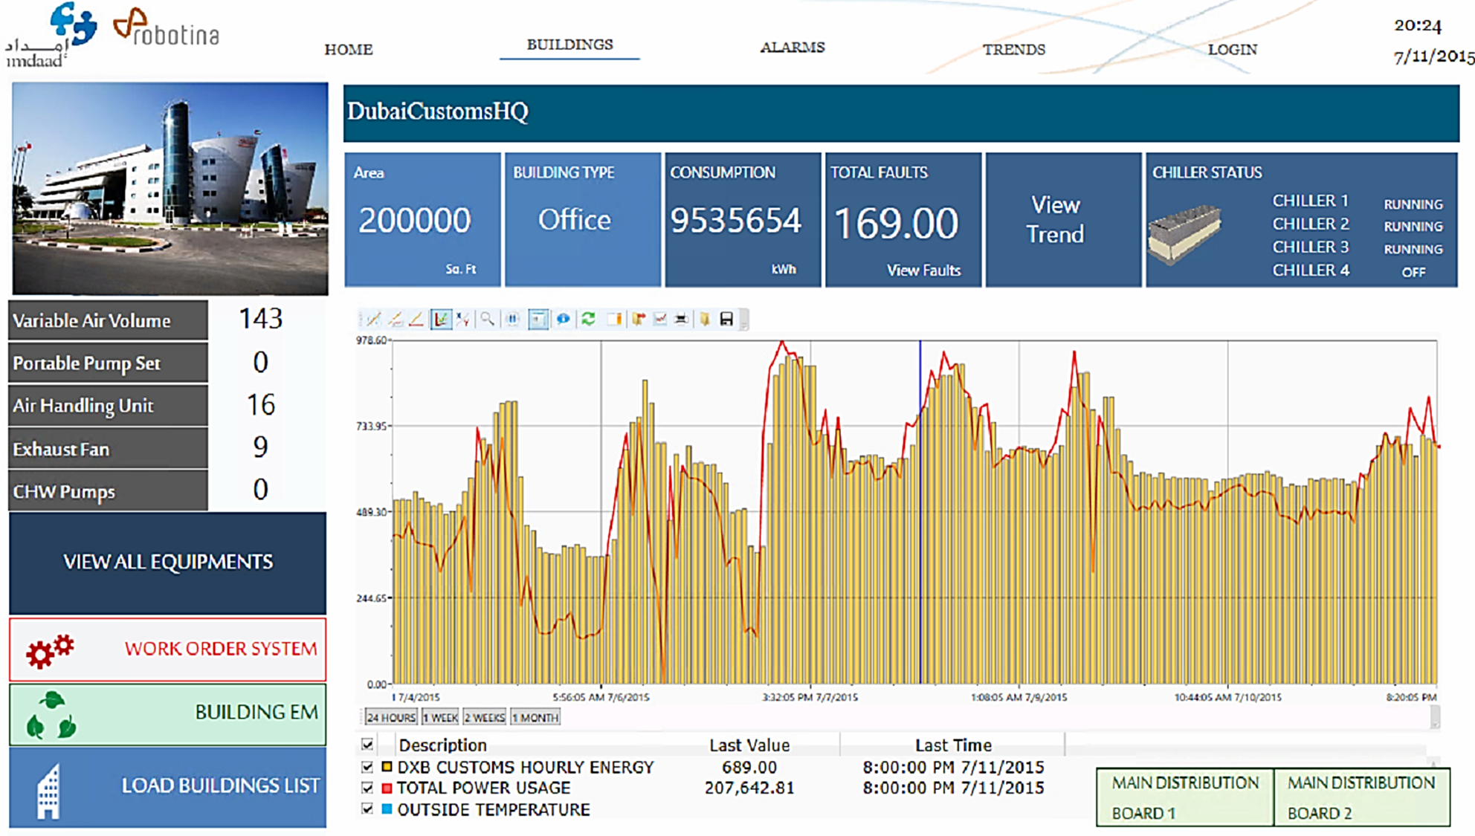
COS: Energy Efficiency
Notes:
Villas, appartments, residence

Slide 32
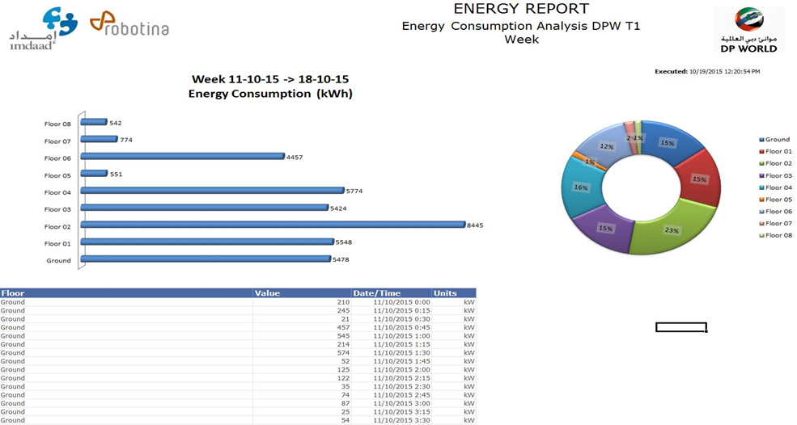
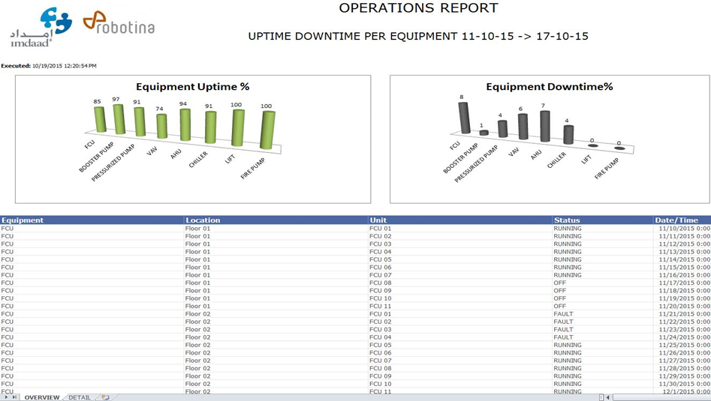
Understanding & optimizing energy flows
Precise Energy Distribution & Consuption
Save on energy expenses
Estimate upcoming energy bills
Breakdown cost per location/system
Improve Environmental Behaviour
Decrease energy waste
Reduce carbon footprint
Support corporate social responsibility

Slide 33
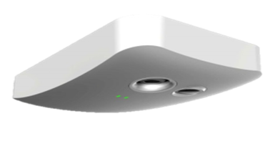
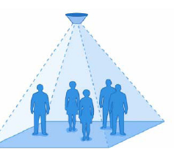
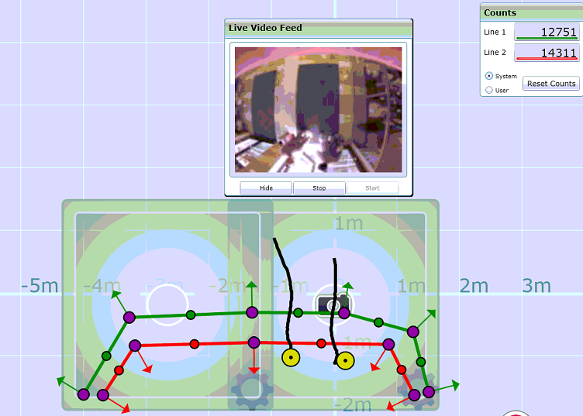
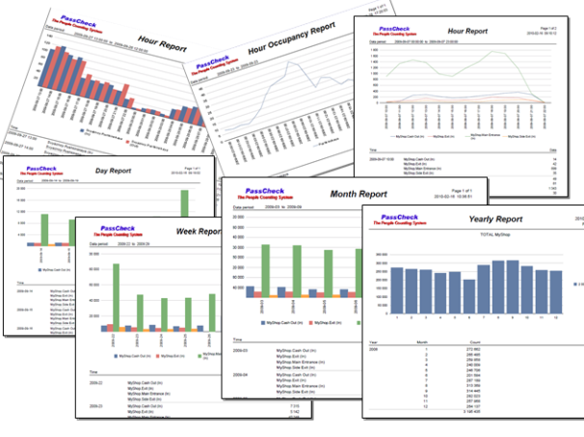
People Counting
Informed action
Highly Accurate
& Consistent
Web Based & fully Automated
Real-time & Historical ; Favorites
Wide range of Reports / Alerts comparisons
Emergency Guidance
Latest tech. sensors with data back up
Easy installation & maintenance
Customizable Reports
Tracking & Tracing
Individual visitor tracking
Identify Frequency of visits
Staff Tracking
Heat Maps
WiFi Ads and marketing
Footfall & occupancy for corelated analysis

Slide 34


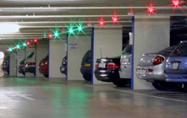
ParkIQ-integrated part of BIQ
Car Park Solutions
PLC Based system
Web Based & fully Automated
Real-time & Historical Alarms
Real GUIDANCE
RGB LED sensors
Reserved space
Automatic configuration
VMS (vehicle messaging)
Automatic Number Plate Recognition
Satisfied customers + data + management = better business

Slide 35
BMS – building intelligence
KEY BENEFITS
Reliable, flexible, industrial grade unified automation hardware & software platform
Modern, High performance SCADA for local and remote operational management
Cognitive Optimization (COS) for best performance and lowest cost & Business optimization
RELATED SOLUTIONS FROM ROBOTINA:
HIQ – Home,
HEMS, BEMS
NOC – advanced operational centre
COS – Cognitive Optimization System
WE DEVELOP & PRODUCE HARDWARE, SOFTWARE AND PROVIDE SAAS
Notes:
Villas, appartments, residence

Slide 36
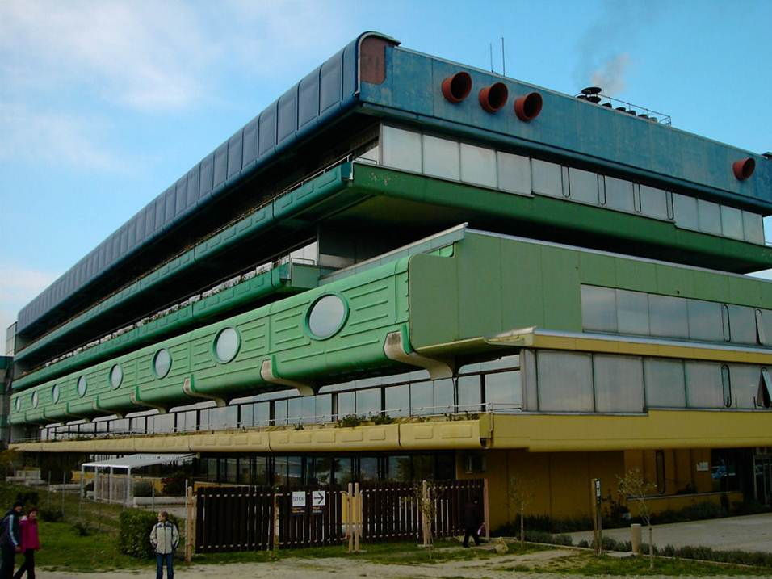
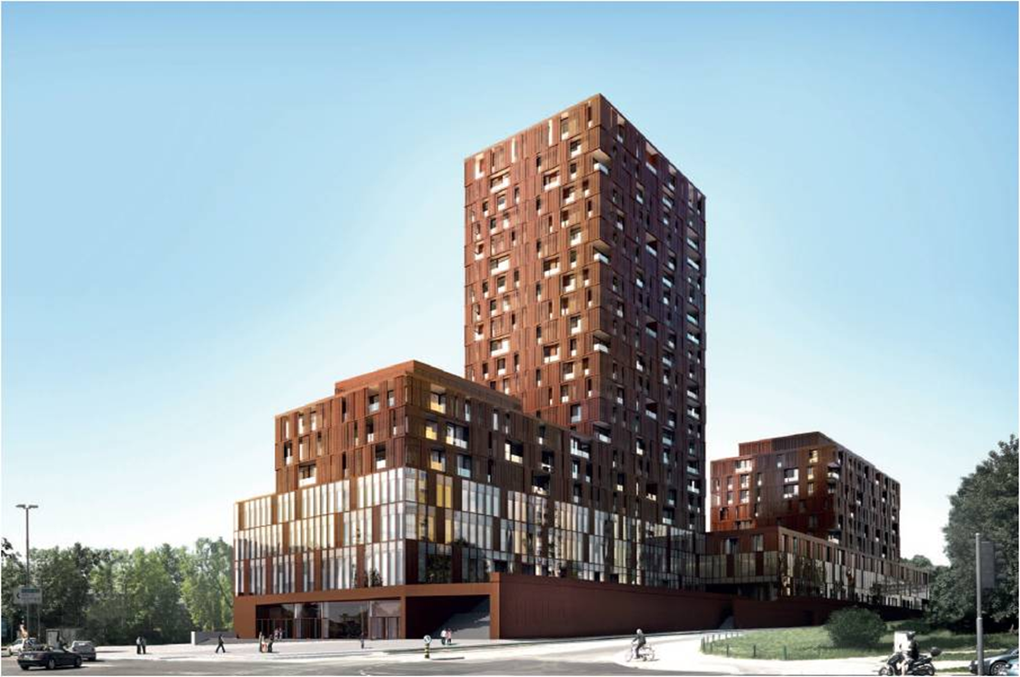
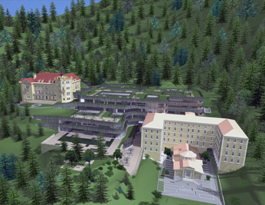


BMS
automation
operation
optimization
HOME, BUSINESS, HOSPITALITY, AMBIENT ASSISTED, PUBLIC…
Notes:
+ real time control and monitoring
+ comfort
+ platform for FM
+ platform for EM

